Slide 1
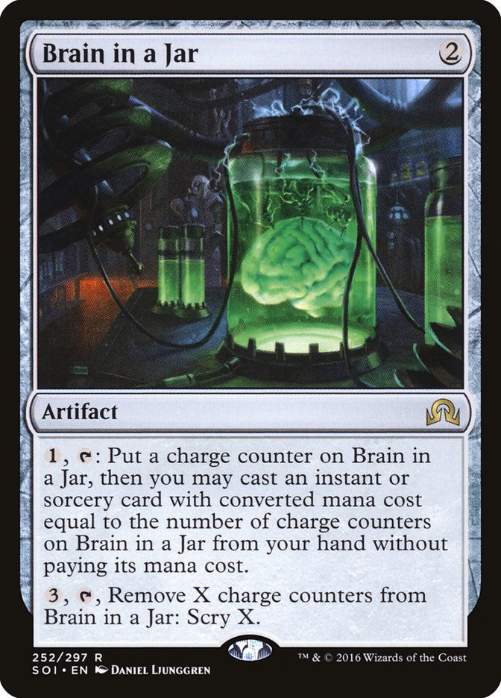

Keeping Your Intelligence Local (and Cheap)
by Nicholas Coats

Slide 2
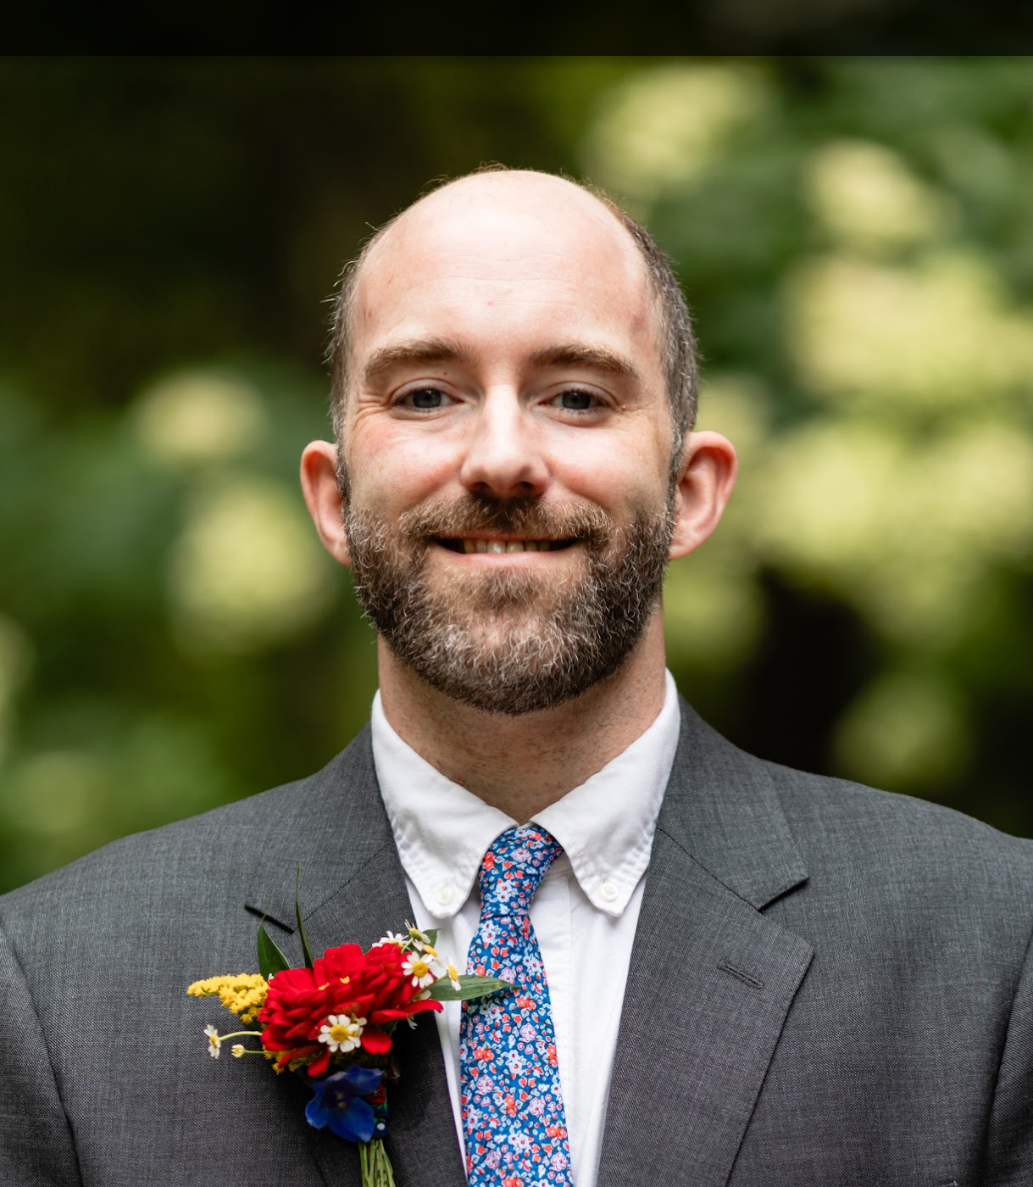
% whoami
Name: Nicholas (Nick) Coats
Career: Sr. Consultant @ Nationwide
Specialties: Cloud Computing, Software Development and Architecture, DevSecOps
Hobbies: Science Fiction, Non-Fiction Science, Music Making, Social Gathering, History, Politics, Video Games, AI
Relevant Experience: Not much, honestly
Notes:
Can pretty this up with a visual …. Hand drawn on iPad?

Slide 3


All Presentation Materials on Github
https://github.com/coatsnmore/keeping-your-intelligence-local
Notes:
Can pretty this up with a visual …. Hand drawn on iPad?

Slide 4
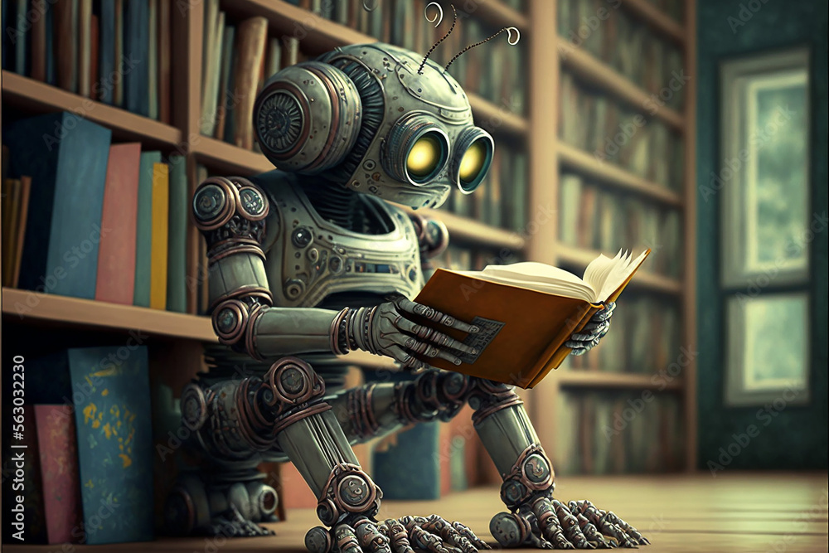
A Few Quick Definitions
Gen AI: Generative Artificial Intelligence
AGI: Artificial General Intelligence (roughly human)
ASI: Artificial Super Intelligence (better than human)
LLM: Large Language Model
Token: Roughly a “word” but not limited to
Embeddings: Numerical representations of text
Context: Information surrounding the token that produces meaning
Agent: AI system with perception; often characterized by independent action
CAG: Context-Augmented Generation
RAG: CAG with remote data
Modalities: The type of data the model processes (text|vision|audio)
Quantization: Reducing precision on model weights to create smaller models
LoRA: Low-rank Adaptation - fine-tuning “low rank” matrices for better performance
Model weights: matrices of number representing the relationship between tokens
CoT (Chain of Thought): coercing the LLM to think “step by step”
Notes:
Can pretty this up with a visual …. Hand drawn on iPad?

Slide 5
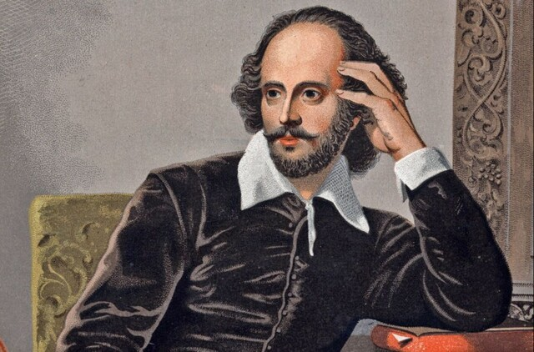
Generative AI
“To be or” ~=> “not to be”
(inference)
“Generative AI, a mere dispenser of tokens it be; ne'er shall it rival the wit and craft of me.”
- Shakesbeer
Notes:
Let’s start off with some alignment.. We are talking about generative AI. This is at its most basic level a token dispenser.

Slide 6
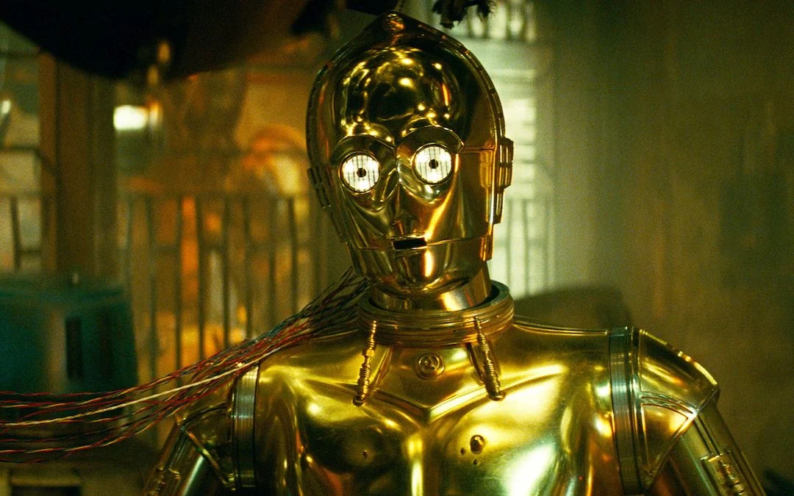
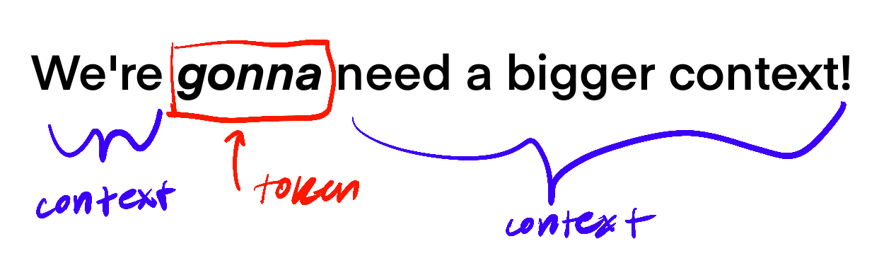
Token

Slide 7

A Basic LLM
LLM: Large Language Model
Notes:
Simplest use is text completion
Docker ps
Docker exec -it ollama /bin/bash
ollama
Ollama ps
Ollama list
Ollama run tinyllama
# notes
Basic LLM - Token Generation
Choosing model
Ollama as standalone app

Slide 8
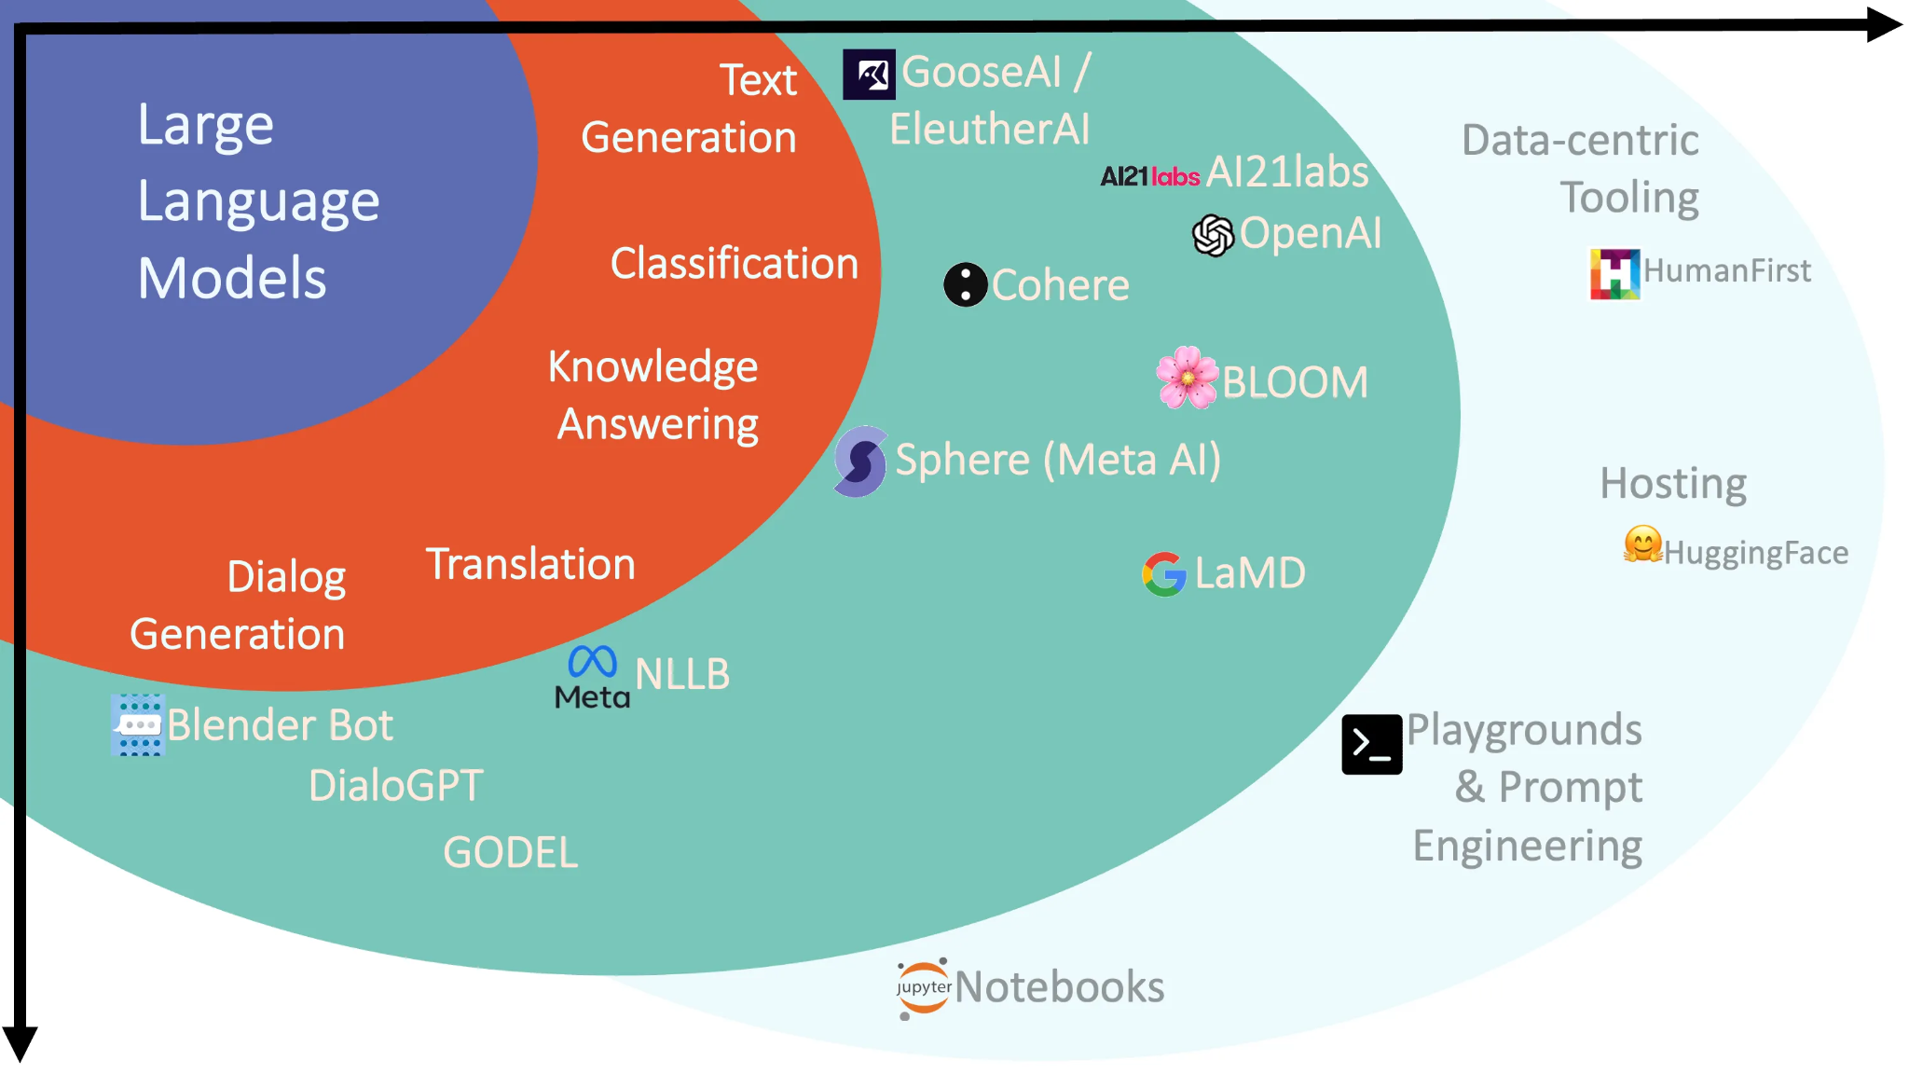
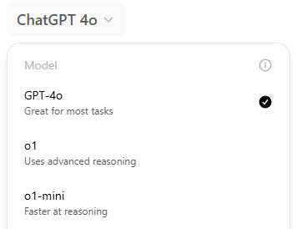
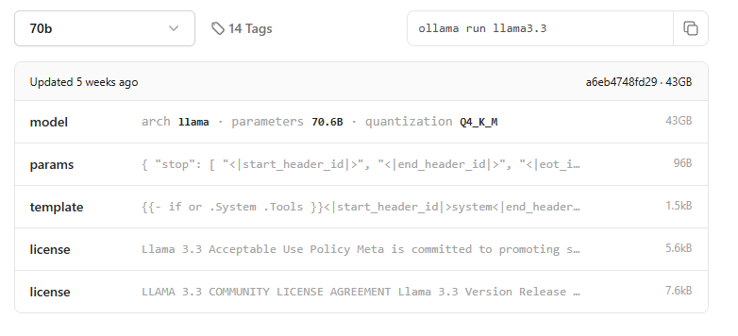
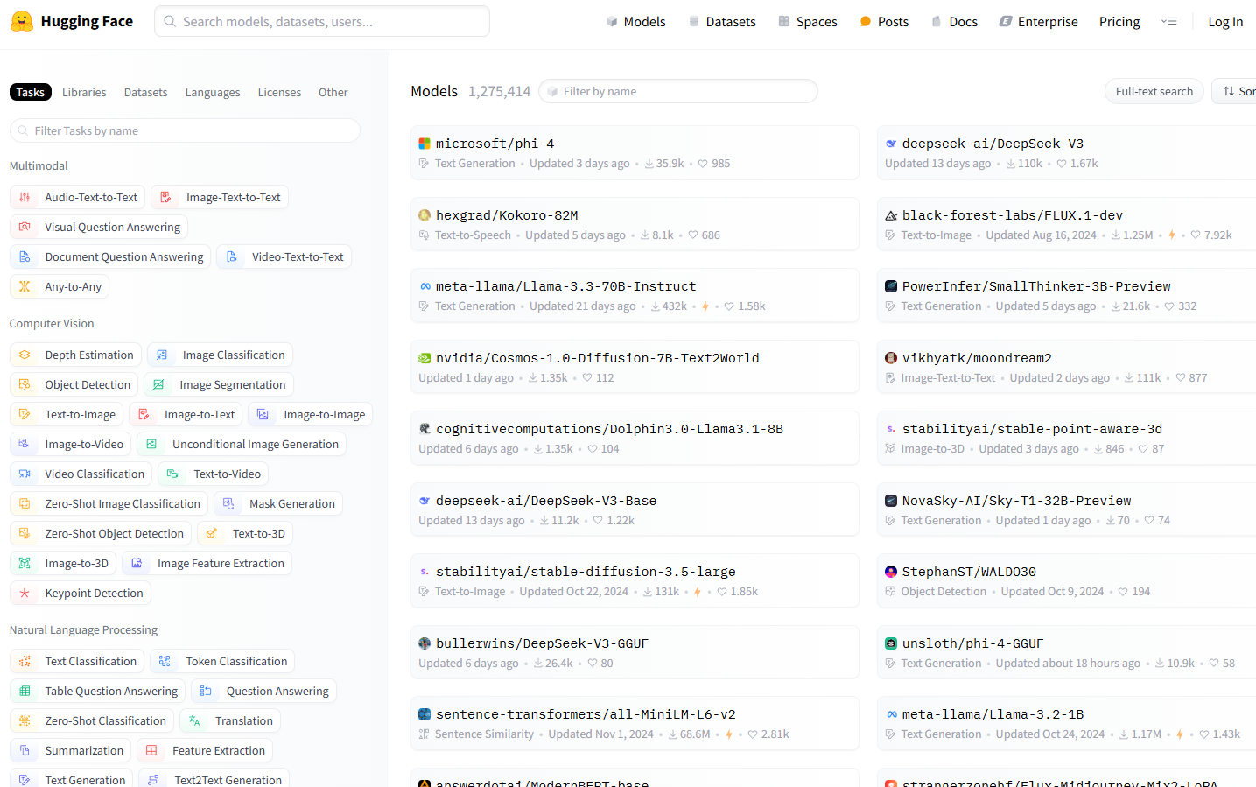
Choosing a Model
Notes:
Ollama show tinyllama
Bruno > Show Details of a Model
Look at GGUF format, clip family
https://ollama.com/search
Each

Slide 9
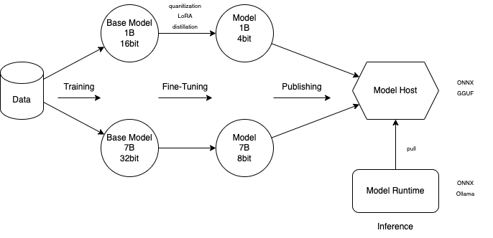
Models at a High Level
Modalities: The type of data the model processes (text|vision|audio)
Quantization: Reducing precision on model weights to create smaller models
LoRA: Low-rank Adaptation - fine-tuning “low rank” matrices for better performance
Model Weights: matrices of number representing the relationship between tokens
Notes:
Find some data
Train the model
Fine-Tune for quality, precision, efficiency
Publish the model somewhere
Choose a runtime

Slide 10
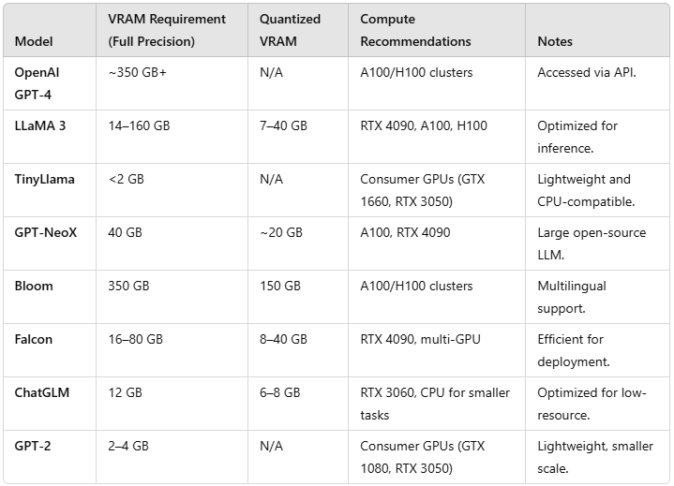

Hardware Requirements

Slide 11
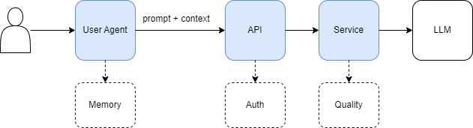
Let’s API Enable that Bad Boy
Notes:
Show Docker setup with volumes / ports
./load-model.sh tinyllama
./test.sh tinyllama
./cats.sh tinyllama
./cats.sh llava
#Notes
REST API
Different endpoints
Abstraction starts

Slide 12
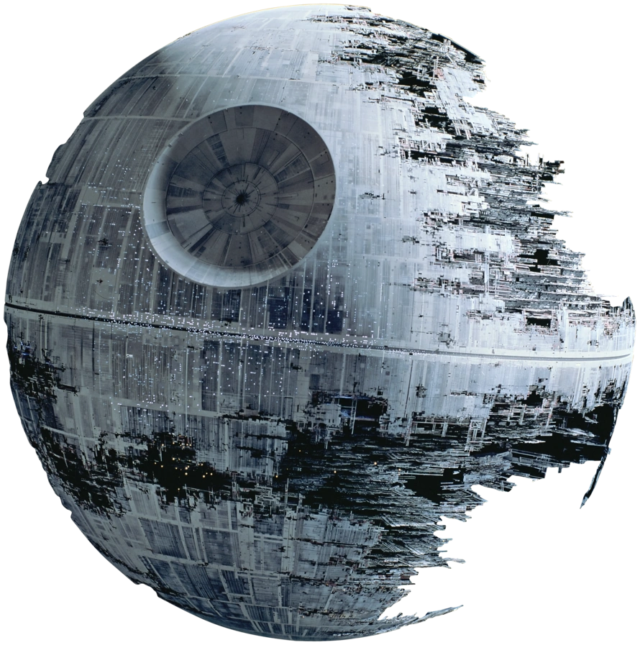
Risks of Cloud
Vendor lock in
Data gravity
Data privacy (personal, IP, business process)
Subject to vendor guardrails (censored)
Variable Cost
Notes:
Can pretty this up with a visual …. Hand drawn on iPad?

Slide 13
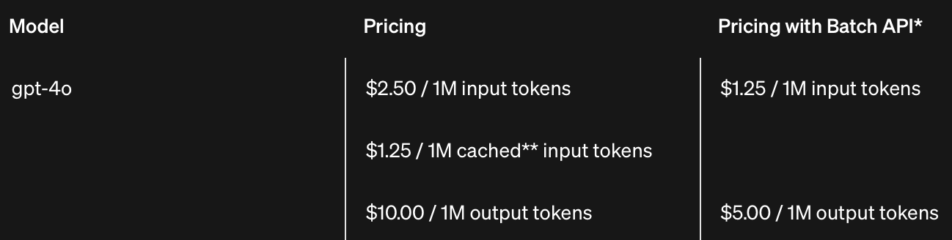
Pricing
https://openai.com/api/pricing/

Slide 14
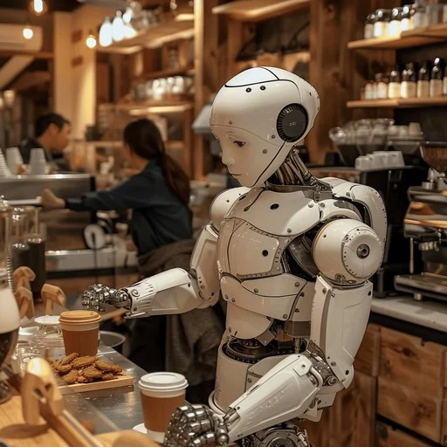
Coffee Numbers
For every 1 Million tokens, it costs about $3.125.
If we ran locally instead, we could eventually buy a coffee.
TTC (Time to Coffee) = How many times it would take to recoup a coffee worth of savings.

Slide 15
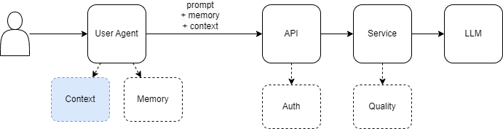
Context Augmented Generation
Notes:
Provide context outside of the prompt
Could be conversation history
Could be local files
App needs to parse files and include in prompt
Some products may include some memory in service

Slide 16
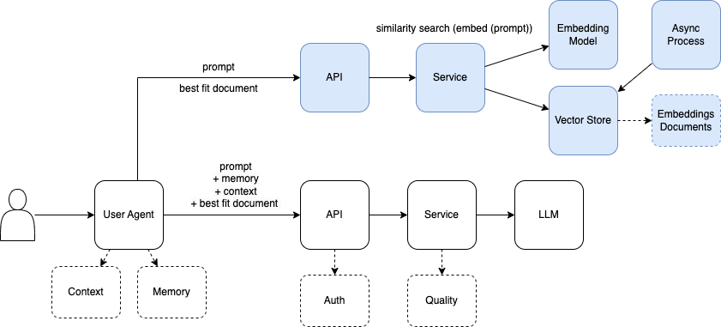
Retrieval Augmented Generation
Notes:
./embed.sh

Slide 17
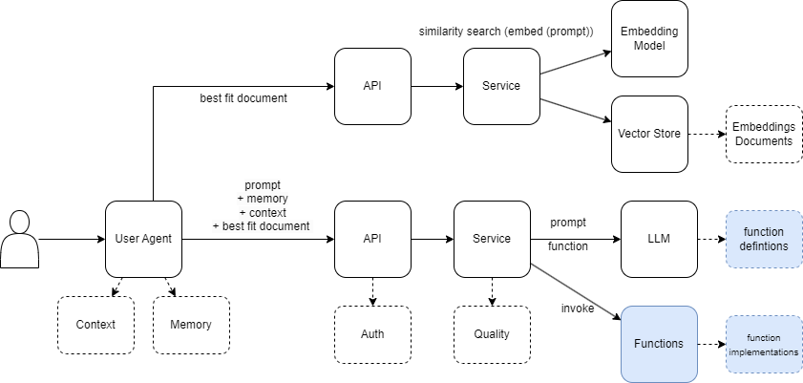
Agentic Systems - Workflows AKA Pipelines
Notes:
“Agentic Systems”
Structured output (JSON)
Tuned Models are better at this
Returns function definition for “function calling”
./structured.sh

Slide 18
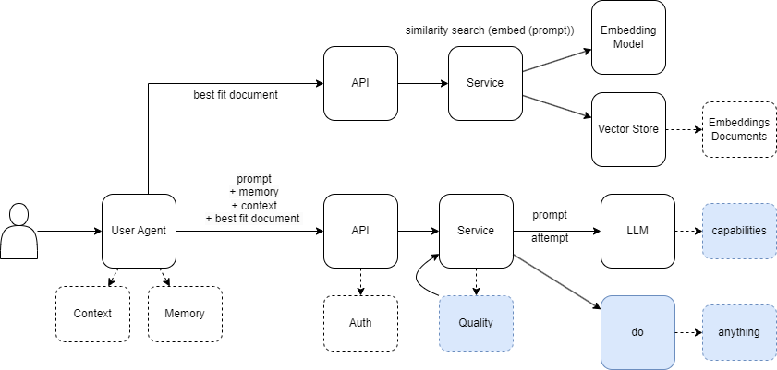
Agentic Systems - Agents
Notes:
Exit docker container (python on host)
./code.sh - repeat until correct
Agents are a generic term, but generally have some common qualities:
Some level of autonomy “go get it done”
Better quality / longer cycles
Not confined to existing paths but has permission boundary (or should have)
Container analogy where container = namespaces + cgroups…. Process can do anything as long as it stays within parameters
“Augmented LLMs”
“Building Effective Agents” https://www.anthropic.com/research/building-effective-agents

Slide 19
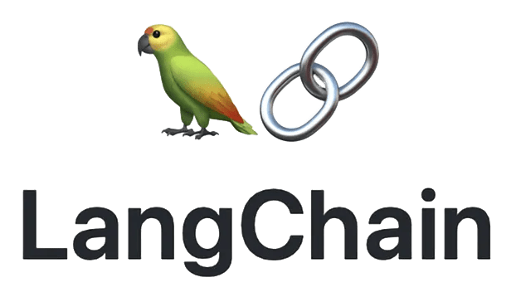



OSS Frameworks
Notes:
Plenty of frameworks attempting to abstract these fundamentals
Some OSS, some proprietary
Some legitimate advantages, e.g. Redis semantic cache… has some concept for cached vector search

Slide 20
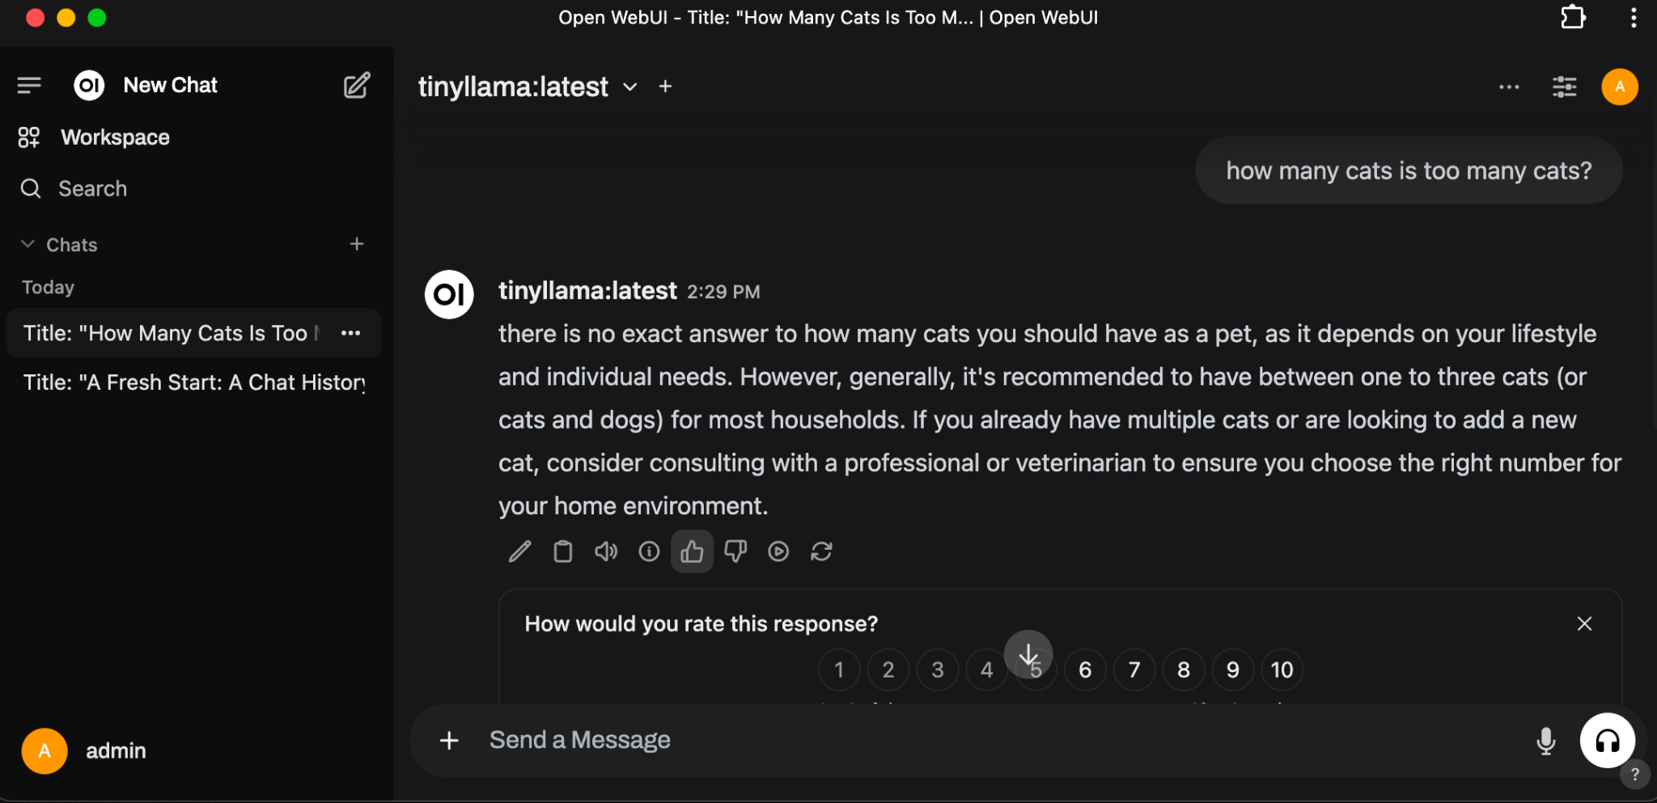
Open Web UI
https://docs.openwebui.com/ http://localhost:3000/
Notes:
Open Web UI
Demo basic product
Prompt arena
Image analysis
Mention Image Generation

Slide 21

IDE Integration
https://www.continue.dev/
Notes:
Demonstrate (cmd + L) with section of code from test.sh

Slide 22
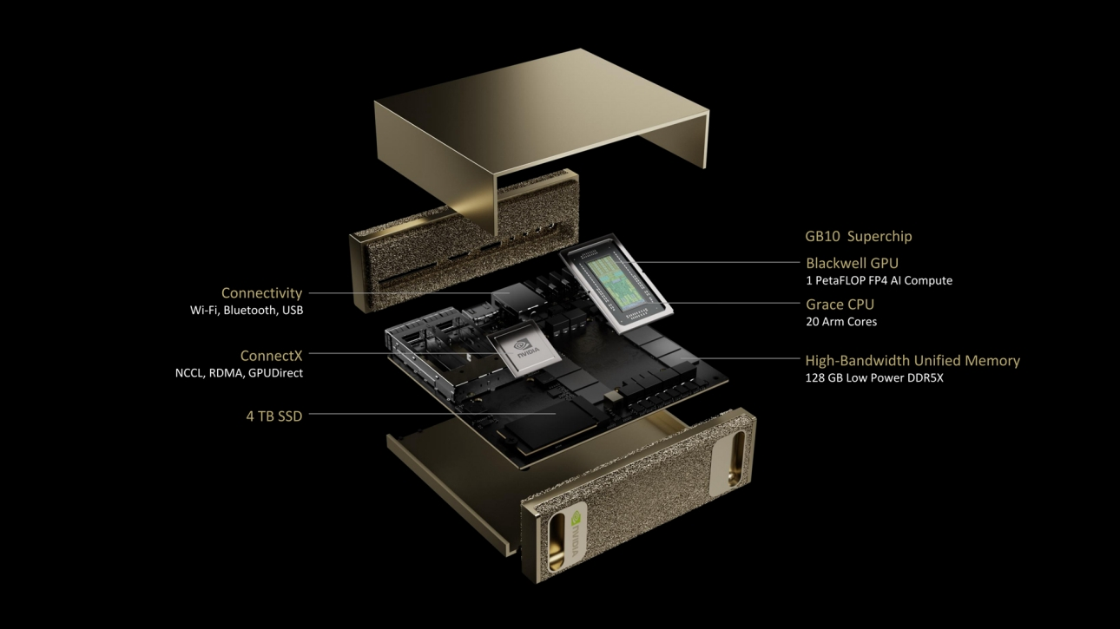
Some Recent Advancements
NVidia’s DIGITS ($3k)
Jetson Nano ($250)
Notes:
Local capability could greatly expand

Slide 23
Summary
Gen AI Fundamentals
Token Generation
Chat Completion
Image Analysis
Structured Output
Function Calling
RAG Fundamentals
Products are iterating abstractions on top
AWS Bedrock, GCP VertX, Azure Open AI
SaaS Products inherit the risk of the cloud
Vendor Constraints
Security
Variable Pricing
Hyperscalers have a severe advantage in terms of competition
And there is no end in sight
Local AI
We rely on the blessings of Meta and other open researchers
Start saving now for your Gen AI home appliance

Slide 24
A Tale of Two Cities (Closing Thoughts)
The Outwardly Optimistic Capitalists that Watch Gotham from the Skyscraper
“We believe we’ll have agents acting as Mid-Level Engineers in 2025” - Zuckerberg (Meta)
“We are no longer hiring humans.” - Sebastian Siemiatkowski (Klarna)
“The TAM (Total Addressable Market) is in the trillions.” - Marc Benioff (Salesforce)
“We believe that, in 2025, we may see the first AI agents “join the workforce” and materially change the output of companies.” - Sam Altman (Open AI)
The (Mostly) Silent Pragmatists Walking Through the Market
“When the poor have nothing to eat, they will eat the rich.” - French Proverb
“In a worse case, AI trillionaires have near-unlimited and unchecked power, and there's a permanent aristocracy that was locked in based on how much capital they had at the time of labour-replacing AI.” - L Rudolf (Captial Will Matter after AGI)
“Our dreamtime will be a time of legend, a favorite setting for grand fiction, when low-delusion heroes and the strange rich clowns around them could most plausibly have changed the course of history. Perhaps most dramatic will be tragedies about dreamtime advocates who could foresee and were horrified by the coming slow stable adaptive eons, and tried passionately, but unsuccessfully, to prevent them.” - Robin Hanson (This is the Dream Time)
Notes:
It may get worse before it gets better
Companies are going to keep consuming
Hyperscalers will keep generating better models
We’ll get better local models

Slide 26
Appendix
Presentation Materials Repository (github)
CAG vs RAG
Understanding RAG
Capital Will Matter with AGI
Building Effective Agents

Slide 27




Gaming Computer Results
Basic Prompt
Structured Output
Cats
Embed

